Slide 1
IMDB Movie Reviews
Brandon Mcghee ~ Sam Newcomer ~ Dylan Mumm

Slide 2
Dataset Description
Official compiled datasets from IMBD’s website
Filtered to only movies with more than 600 reviews
Resulting in 41,000 listings
Quantitative - number of votes, number of movies in each genre
Ordinal - year
Categorical - genres
Number of votes is the amount of people gave a review on a single movie
Number of movies in each genre is the total number of movies in each genre
Genres: Comedy, Crime, Drama, Family, Fantasy, History, Horror, Mystery, Romance, Sci-Fi, Sport
Dataset treats each genre as a boolean attribute, able to for up to 3 genres be “true” for each listing

Slide 3
Story
The film industry is incredibly diverse and caters to a wide audience.
General public
Professional and amateur reviewers
1. What types of films are popular to the general public?
2. Which genre of film are movie reviewers, drawn to or favor?
Examine which film genre the general public is attracted to the most
Examine which film genre film reviewers are attracted to the most

Slide 4
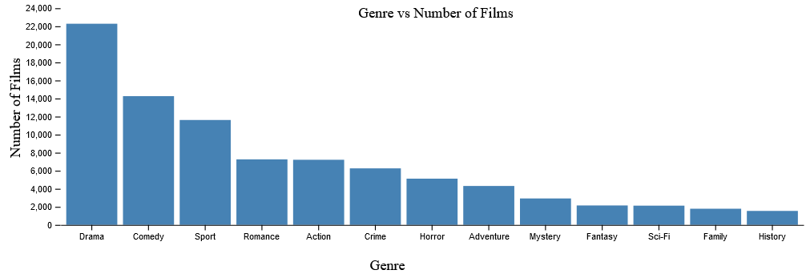
Visualizations
Began with grouping genres
Examined by seeing which kinds of films were produced
Hover over feature for each genre

Slide 5
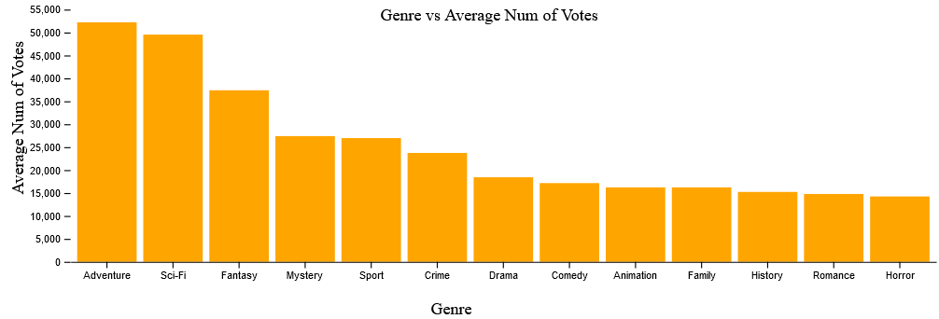
Visualizations
Examined by seeing the average number of votes per genre
Total number of reviews made within a genre

Slide 6
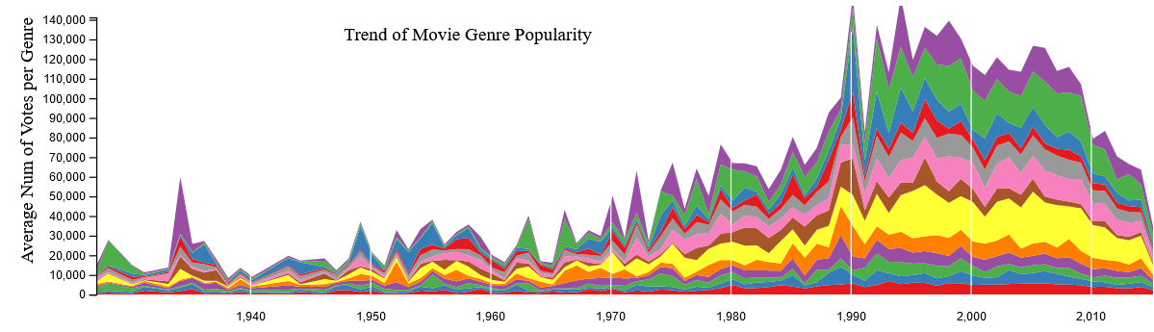
Visualizations
Trend over time
1930 - present
Color represents different genre
Hover over feature for each genre in respective year

